Slide 1


AI-Based Personalized E-Learning Systems
Issues, Challenges, and Solutions
Authors: Mir Murtaza, Yamna Ahmed, Jawwad Ahmed Shamsi, Fahad Sherwani, and Mariam Usman
Presented To:
Farjana Akter Jui
Lecturer , Dept of CSE
Green University Of Bangladesh
Presented By:
Moriam Khatun Id :221002197
Md Sohel Id:221002173
1
1

Slide 2
Introduction
Traditional E-Learning
AI-Based Personalized E-Learning
Delivers the same content to all learners.
Tailors content to individual needs.
2

Slide 3





Research Questions
Key Factors
For personalized e-learning?
Current State
What is the state of the art?
AI Benefits
How AI benefits e-learning?
Future Research
What are future directions?
3

Slide 4





Key Factors for Personalized E-Learning
Adaptability
Adaptivity
Delivers content in preferred modes.
Adjusts content based on comprehension.
2
1
Continuous Assessments
3
Tracks progress.
5
Recommendation Systems
4
Suggests personalized content.
Robust Data Collection
Collects interaction data.
4

Slide 5

Current State of the Art
1
Knowledge Tracing
Tracks learner understanding.
2
Item Response Theory
Evaluates learner performance.
3
Recommender Systems
Suggests personalized content.
4
Gap
Lacks a holistic approach.
5

Slide 6
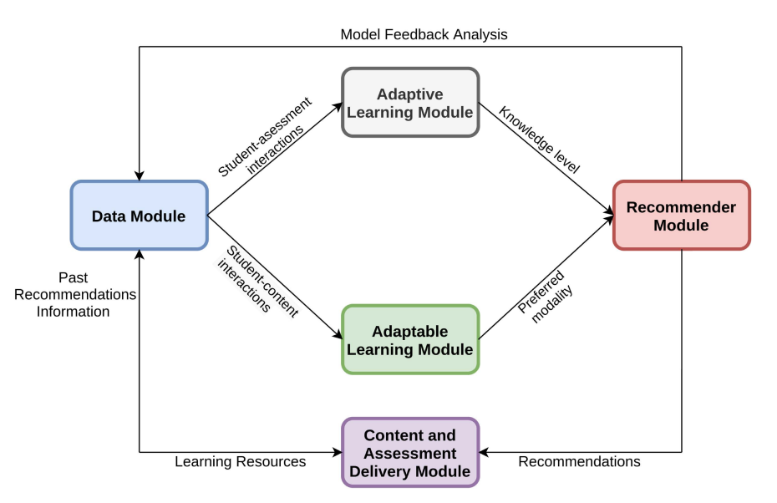
Proposed Framework
6

Slide 7
Future Research Directions
Counterfactual Evaluation
Testing recommendations.
Learner Activity Data
Collecting interaction data.
Learner Evaluation Metrics
Beyond test scores.
Real-Time Personalization
Reducing content delays.
Continuous Evaluation
Assessing progress.
7

Slide 8

Conclusion
Tailored Content
Key Elements
AI personalizes e-learning systems.
Use adaptivity and recommendations.
Future Steps
Improve real-time personalization.
8

Slide 9

Questions?
Thank you!
https://drive.google.com/file/d/1CHo3UfW6KsVqTuhPvXrjzjcvsV2NEv3K/view?usp=sharing
9

